Slide 1

Cyclıstıc
B I K E S H A R E
Google Data Analytics Capstone Project

Slide 2



HELLO!
I am Fatih İlhan
Github: github.com/fatihilhan42 Linkedin: linkedin.com/in/fatih-ilhan Kaggle: kaggle.com/fatihilhan
Data Scientist &
Electrical Electronic Engineer

Slide 3


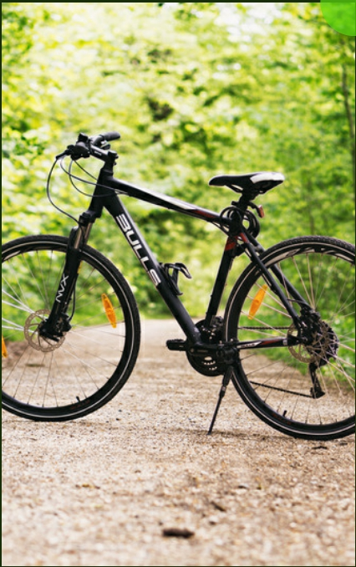
C Y C L İ S T İ C B I K E S H A R E
CONTENTS
Project Purpose The Questions Analysis Summary
FInal ConclusIon and RecommendatIon
Project Resources

Slide 4




C Y C L I S T I C B I K E S H A R E
PROJECT PURPOSE
This project includes a data-based decision-making scenario. Driving data was analyzed and analyzed in order to identify the Cyclistic company's upcoming marketing campaign and trends.
Insights were evaluated in order to enable people who use
the service temporarily to switch to the annual membership plan.
CASUAL MEMBER Presentation Design

Slide 5

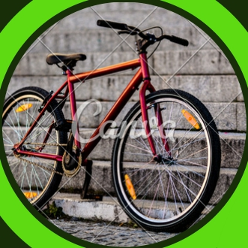
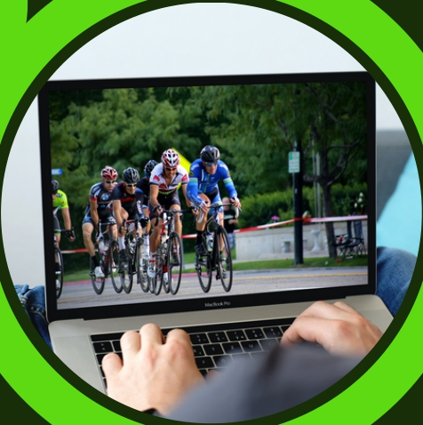

C Y C L I S T I C B I K E S H A R E
THE QUESTIONS
How do annual members and casual riders use
Cyclistic bikes differently?
Why would casual riders buy Cyclistic annual
memberships?
How can Cyclistic use digital media to influence
casual riders to become members?

Slide 6

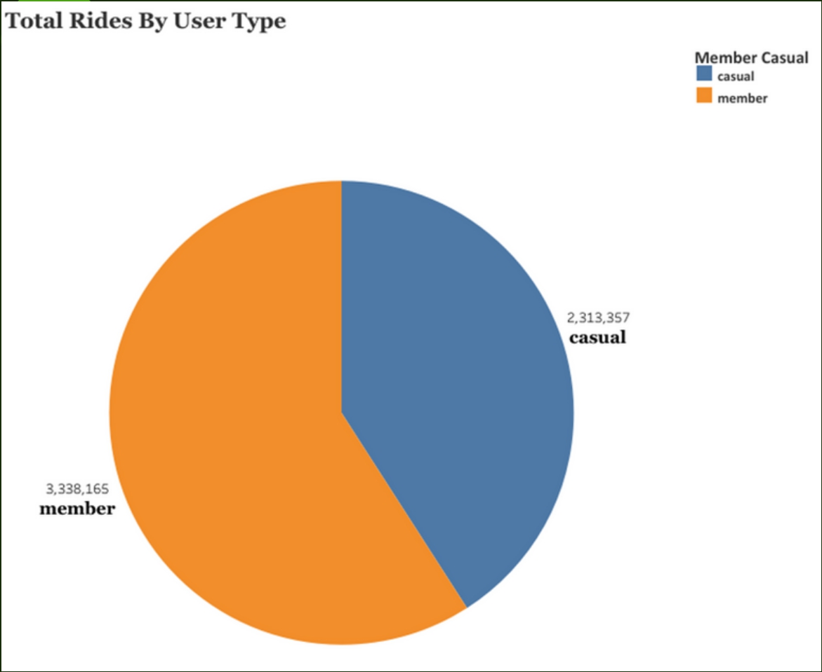
C Y C L I S T I C B I K E S H A R E
ANALYSIS SUMMARY
Total Rides by User Type
59.07%
Member
40.93%
Casual
Of the total 5,651,522 rides, 2,313,357 were made
by casual members and 3,338,165 by annual members.

Slide 7

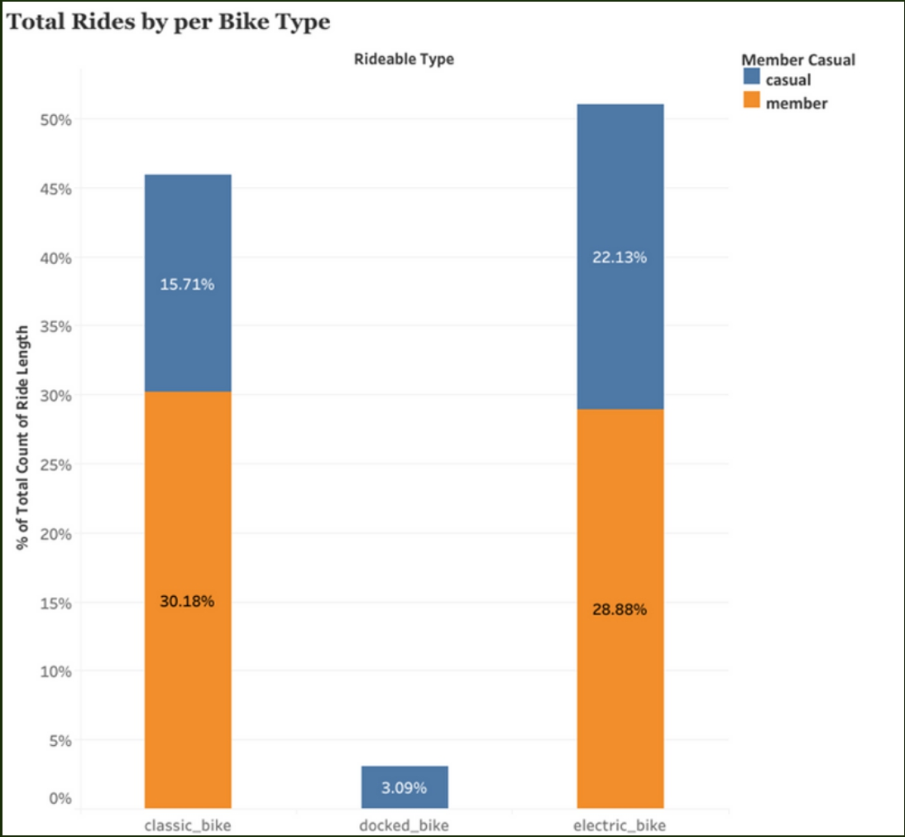
C Y C L I S T I C B I K E S H A R E
ANALYSIS SUMMARY
Total Rides by per Bike Type
While the electric bicycle covers a significant 51% of the total ride, the classical bicycle has a ratio of 45%.
Annual members prefer classic bikes more than Casual riders. The rate of use of electric bicycles is almost close.

Slide 8
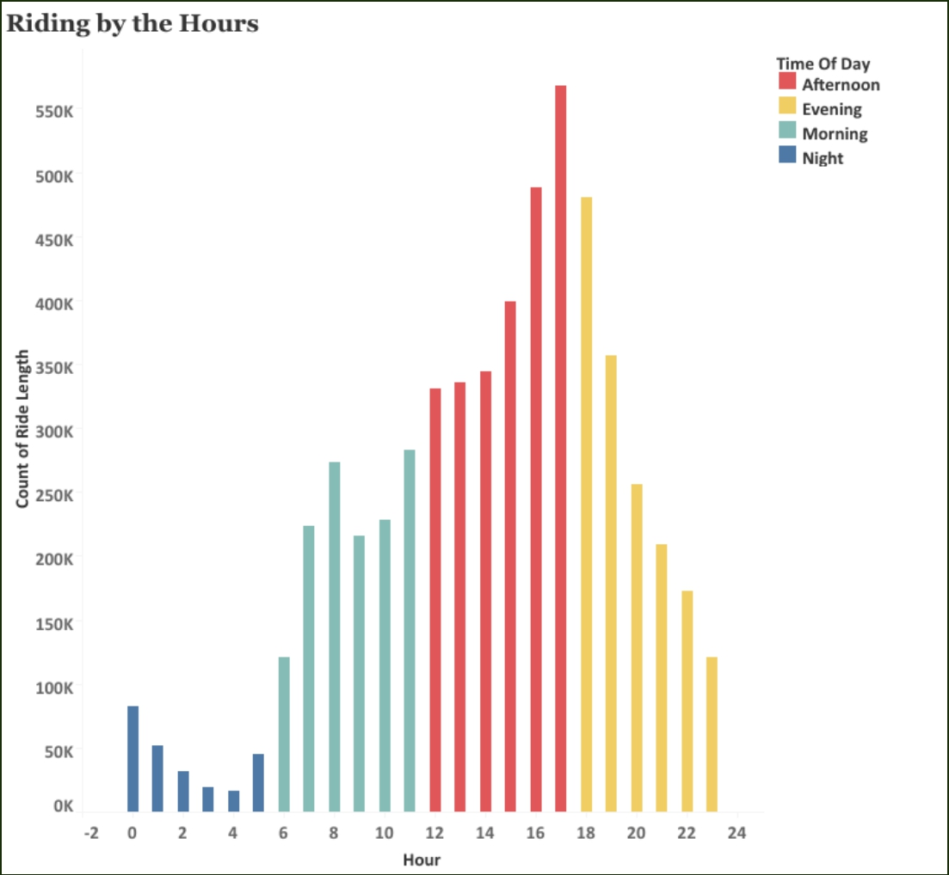
C Y C L I S T I C B I K E S H A R E
ANALYSIS SUMMARY
Riding by the Hours
Users who are very active in the afternoon drive at least at night.

Slide 9
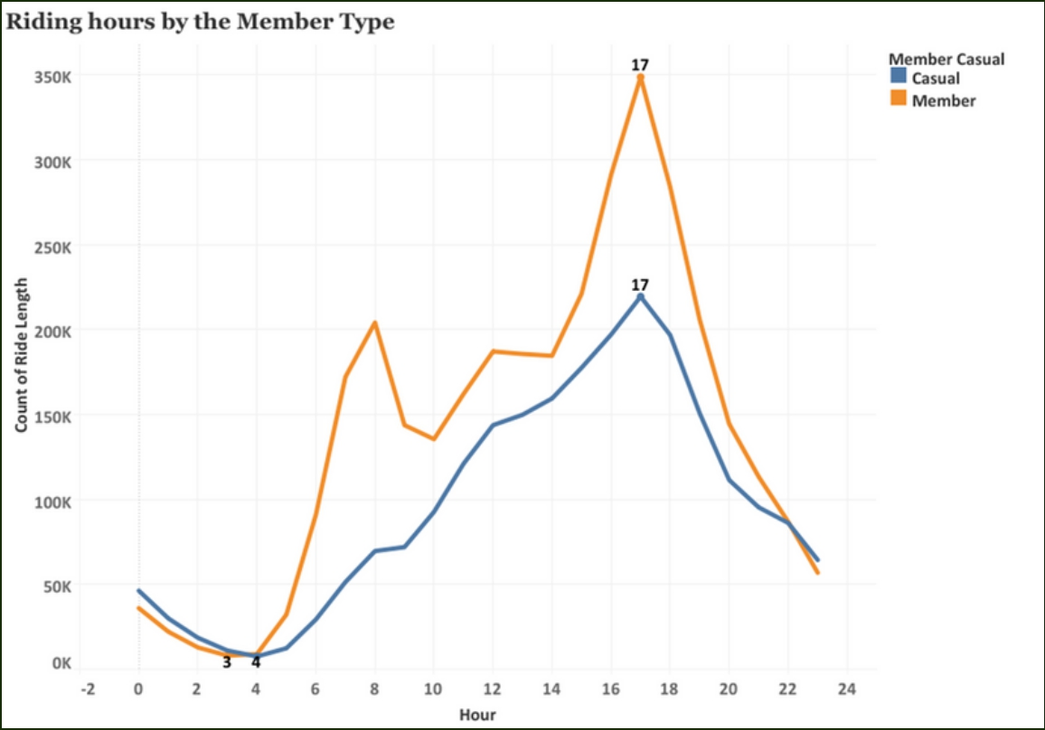

C Y C L I S T I C B I K E S H A R E
ANALYSIS SUMMARY
Riding Hours by the Member Type
Our annual members and Casual riders drive
the most around 5pm. Casual riders ride at a
minimum of 4am, while annual members drive at 3am.

Slide 10
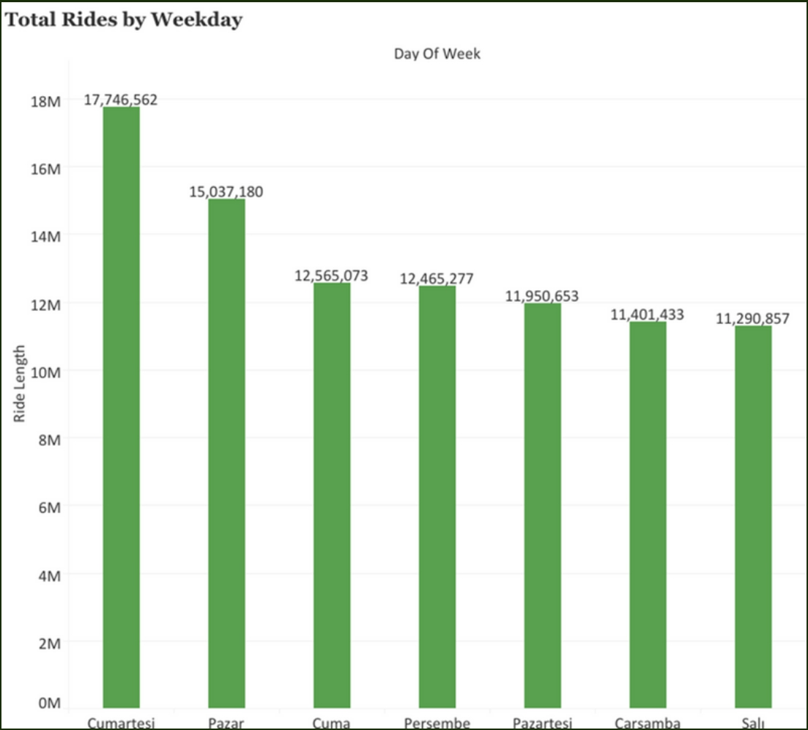
C Y C L I S T I C B I K E S H A R E
ANALYSIS SUMMARY
Riding by the Weekday
Saturday and Sunday are the days with the most driving.

Slide 11
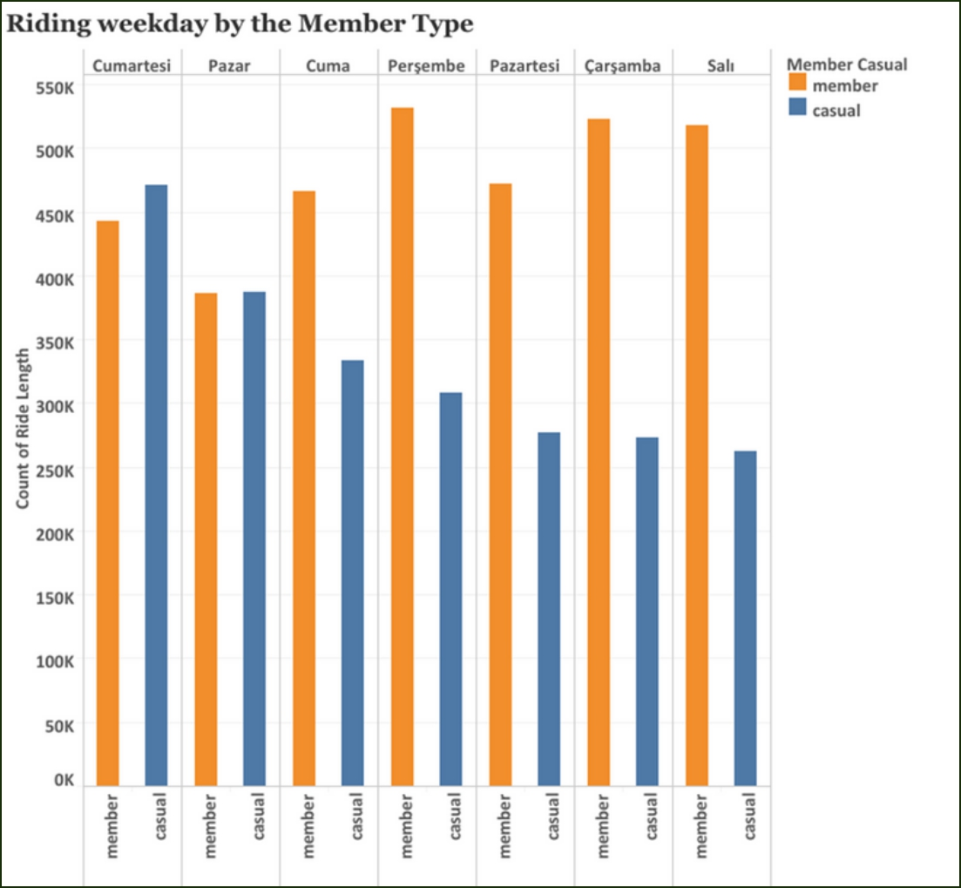
C Y C L I S T I C B I K E S H A R E
ANALYSIS SUMMARY
Riding weekday by the Member Type
Annual members drove the most on weekdays, while casual riders drove more on the weekend.

Slide 12
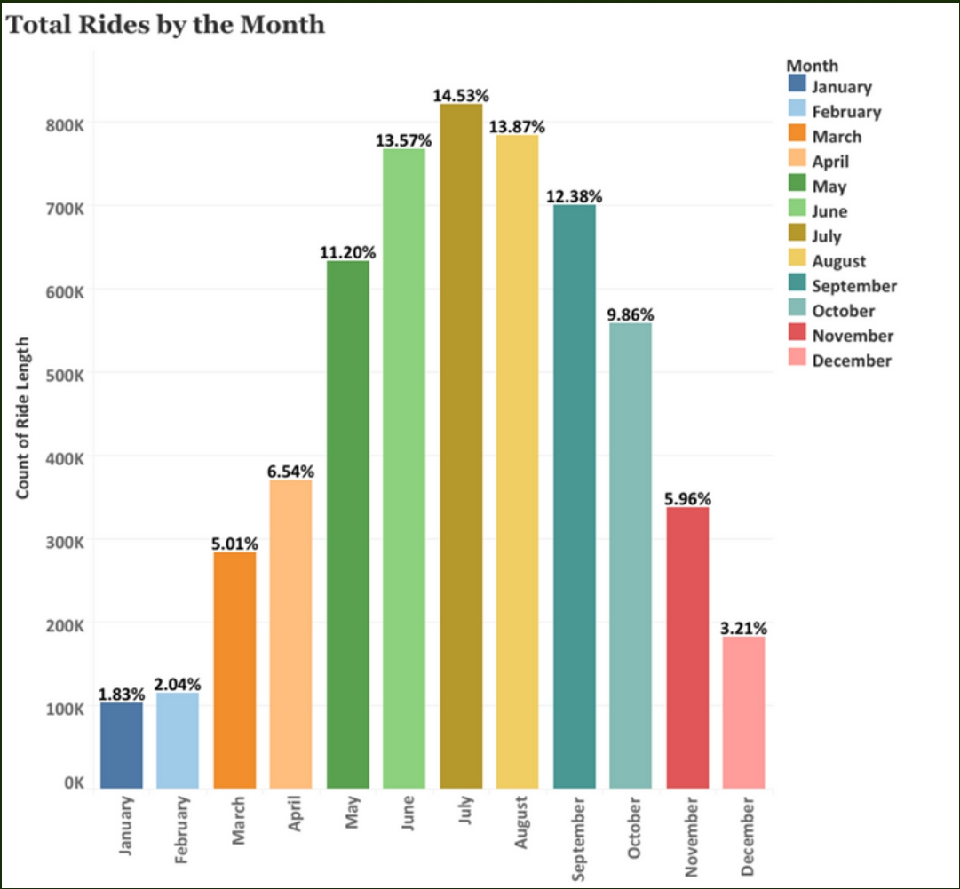
C Y C L I S T I C B I K E S H A R E
ANALYSIS SUMMARY
Rides by the Month
In the summer months, especially in June, July and August, the number of rides was at the highest point,
while the lowest number of rides was in the winter months.

Slide 13
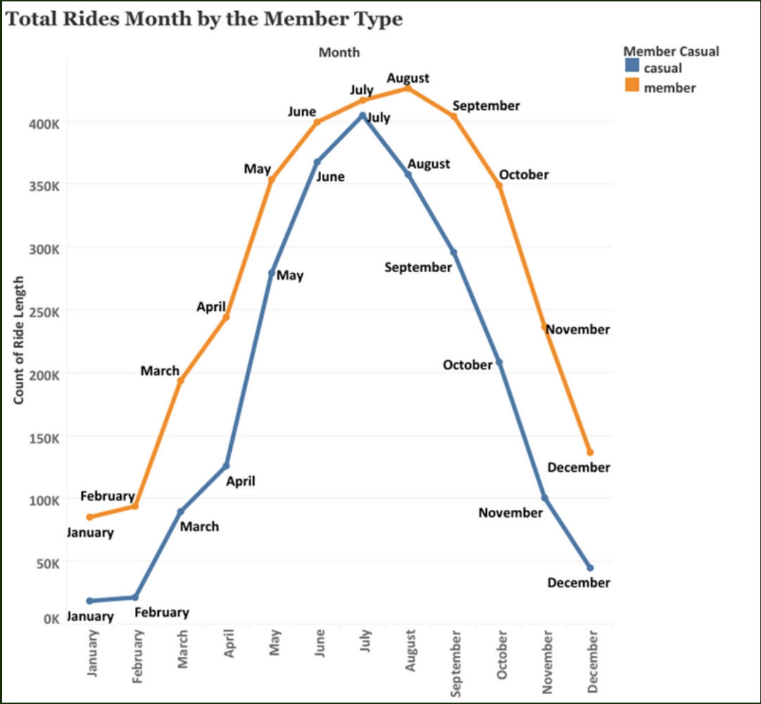
C Y C L I S T I C B I K E S H A R E
ANALYSIS SUMMARY
Total Rides Month by the
Member Type
Annual members drove the most in August, while casual riders drove the most in July. The lowest driving for both user types was in January.

Slide 14

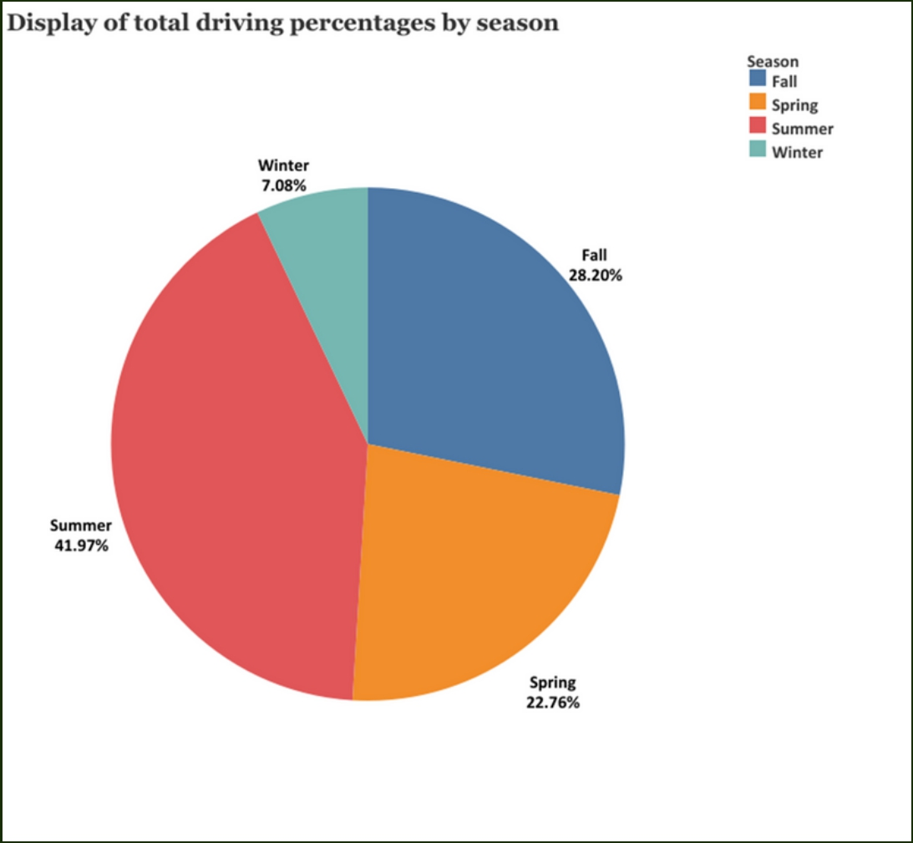
C Y C L I S T I C B I K E S H A R E
ANALYSIS SUMMARY
Total riding percentages by Season
With 41.97%, the most driving was in the summer season, while the least with 7.08% was in the winter season.

Slide 15
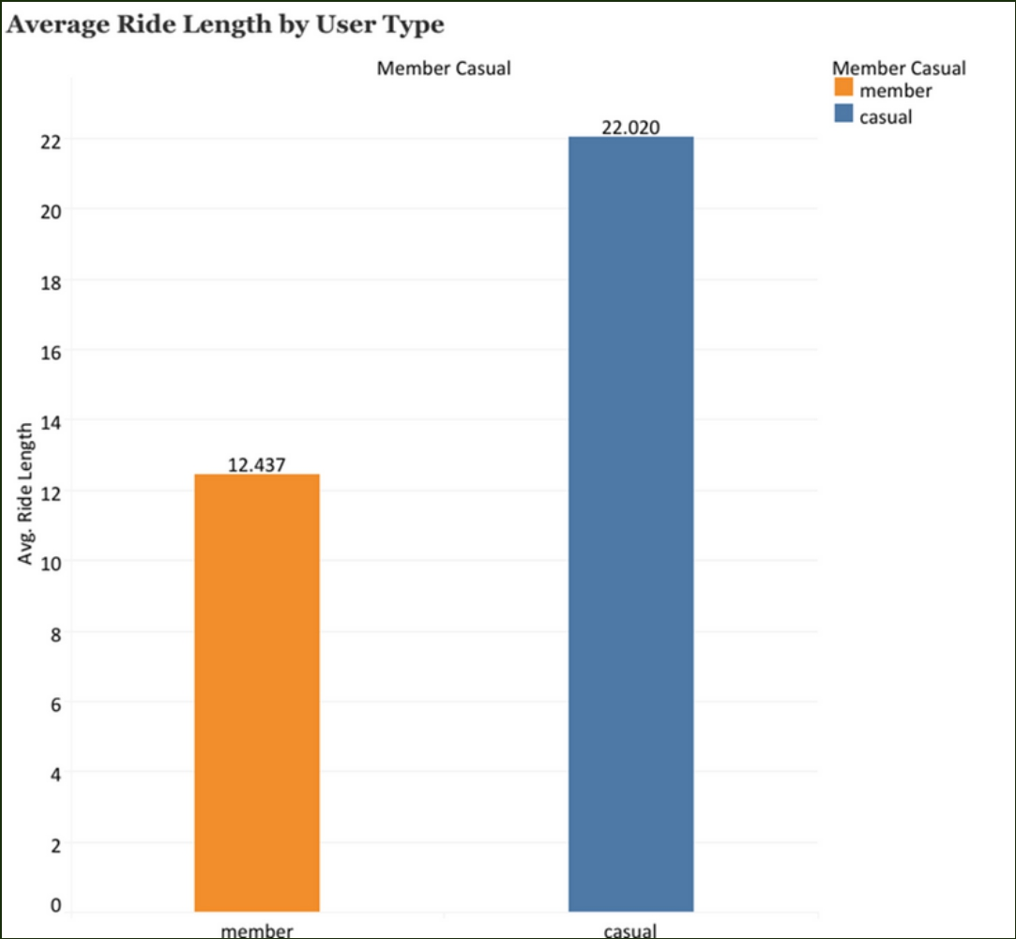

C Y C L I S T I C B I K E S H A R E
ANALYSIS SUMMARY
Average Ride Length by user Type
When we look at the average herd times, there is a significant difference. Casual riders rank first in
terms of average driving time, with more minutes than annual members.
12.437 Min
Member
22.020 Min
Casual

Slide 16
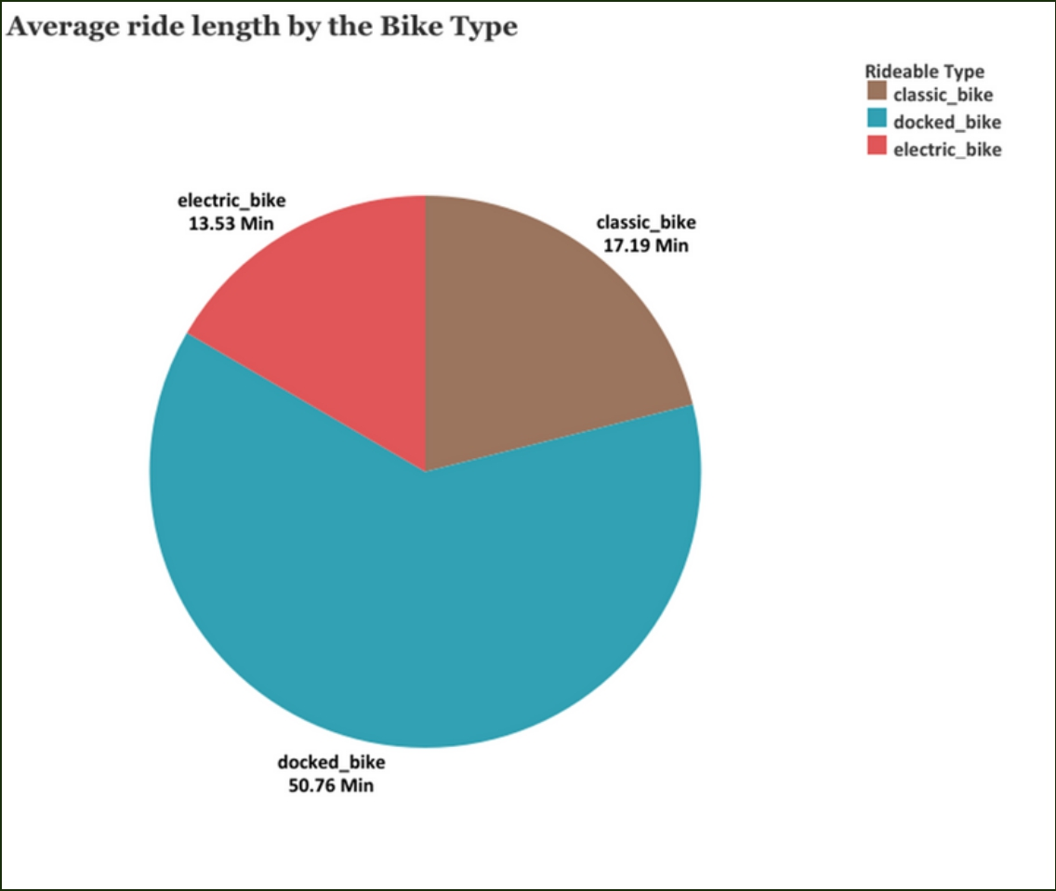

C Y C L I S T I C B I K E S H A R E
ANALYSIS SUMMARY
Average ride length by the Bike Type
While the docked bike is the type of bike with the longest ride with an average of 50.76 minutes, the classic bike
is the second with 17.19 minutes, and the electric bike has the shortest riding time with 13.56 minutes.

Slide 17
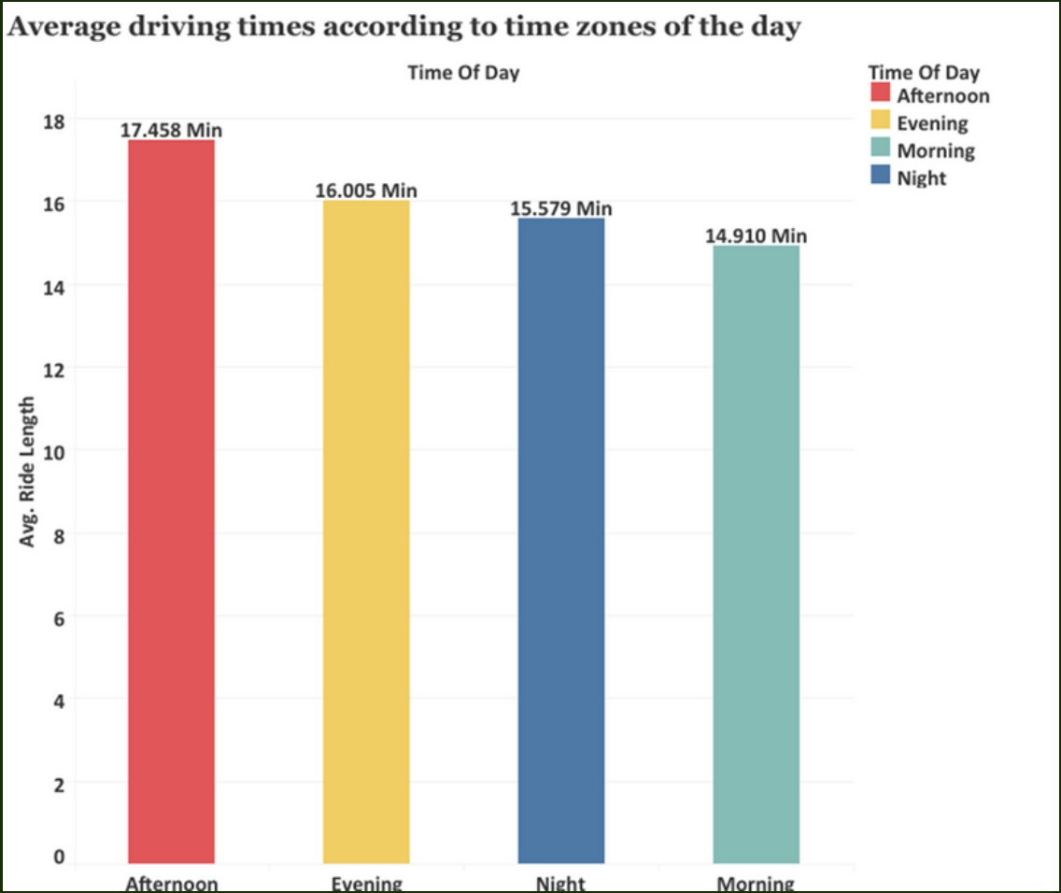
C Y C L I S T I C B I K E S H A R E
ANALYSIS SUMMARY
Average riding times according to
time zones of the day
With an average driving time of 17,458 minutes in the afternoon, it is the time period for the longest rides. The minimum driving time is in the morning hours, while the average driving time is 14,910 minutes.

Slide 18
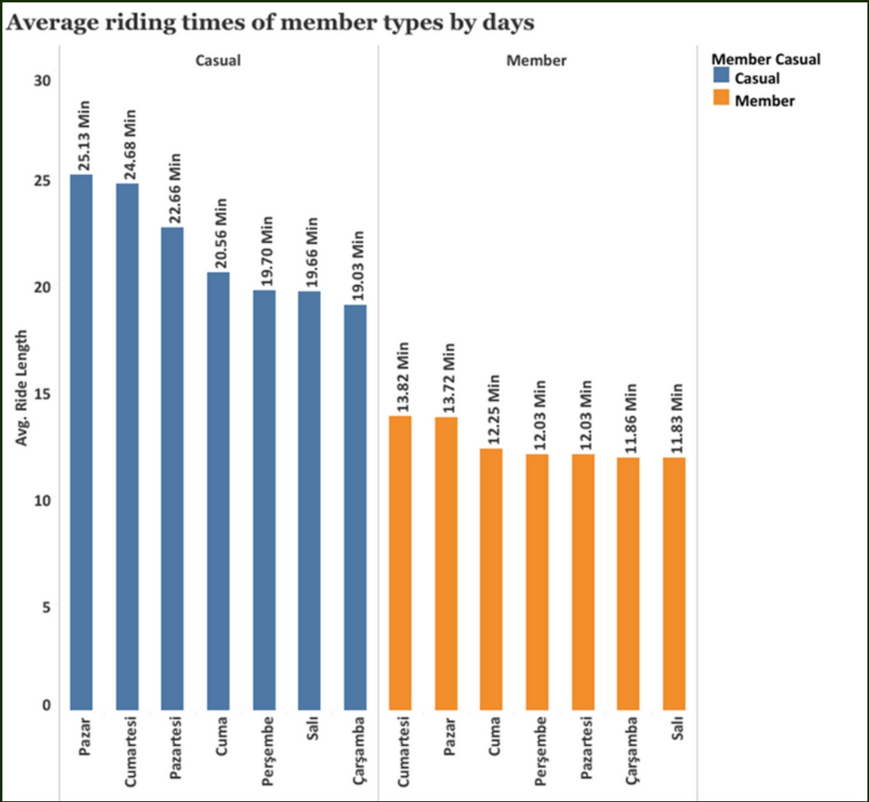

C Y C L I S T I C B I K E S H A R E
ANALYSIS SUMMARY
Average riding times of member types by days
Average driving time is higher on weekends for both types of users. It can be said that casual riders use the service for longer periods on weekends as a sign that they see this activity as a means of entertainment and relaxation.
The fact that the average driving time of the annual members is close to each other clearly reveals that this user type uses the service according to routine habits.

Slide 19
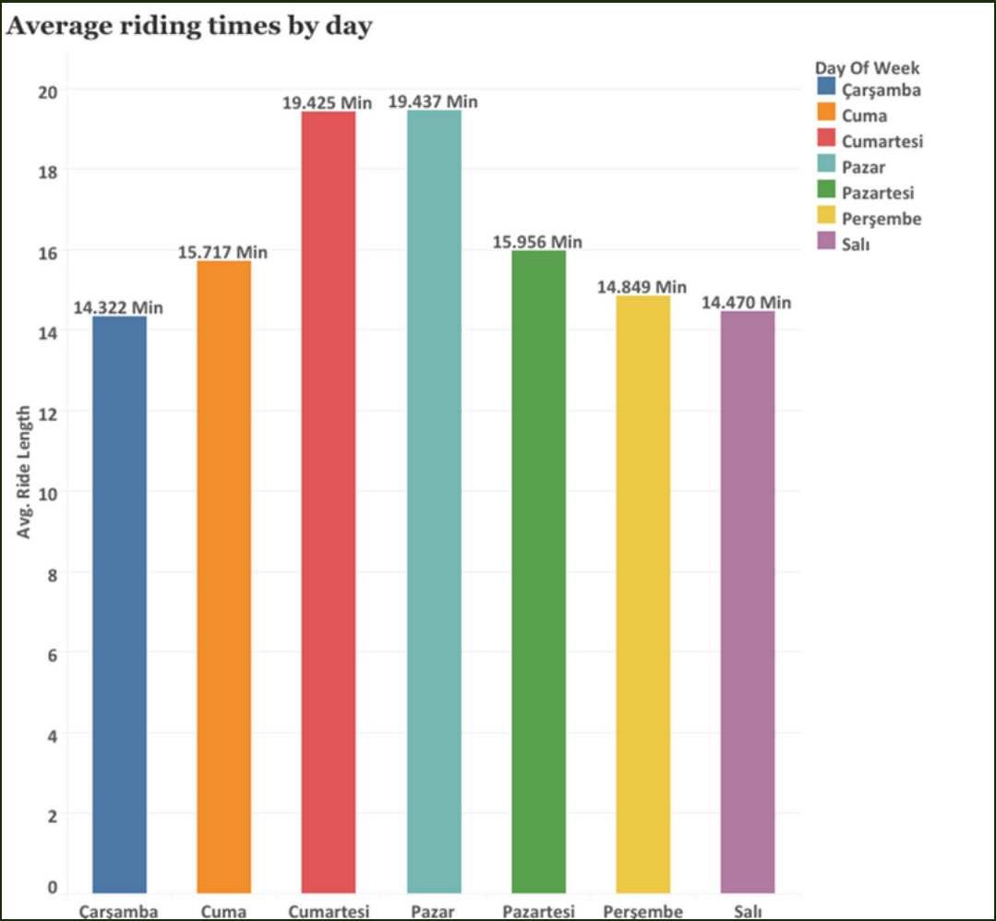

C Y C L I S T I C B I K E S H A R E
ANALYSIS SUMMARY
Average riding times by Day
In terms of average driving time, the longest rides were
made at the weekend. In the middle of the week, the average time decreased to the lowest level.

Slide 20
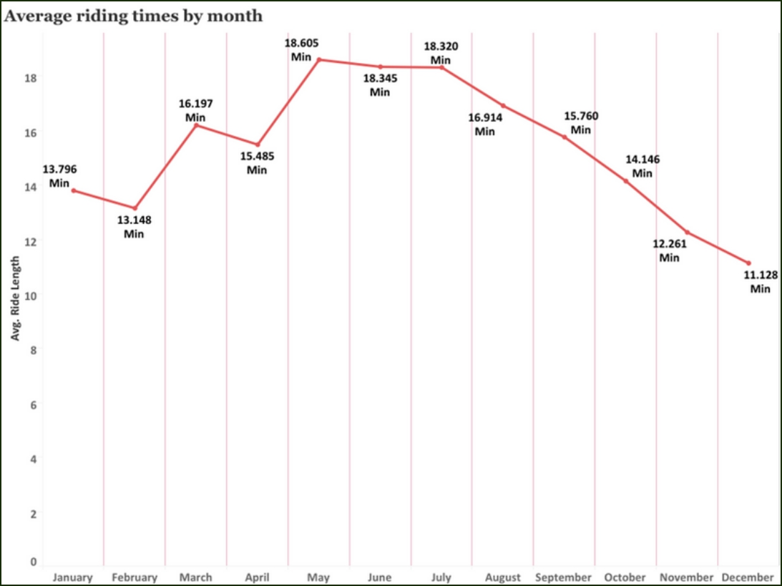
C Y C L I S T I C B I K E S H A R E
ANALYSIS SUMMARY
Average riding times by Month
In terms of average driving time, the longest rides were generally in the summer months of May, June and July. This is due to the fact that cycling activity is thought to be an enjoyable activity with the warming of the weather.

Slide 21
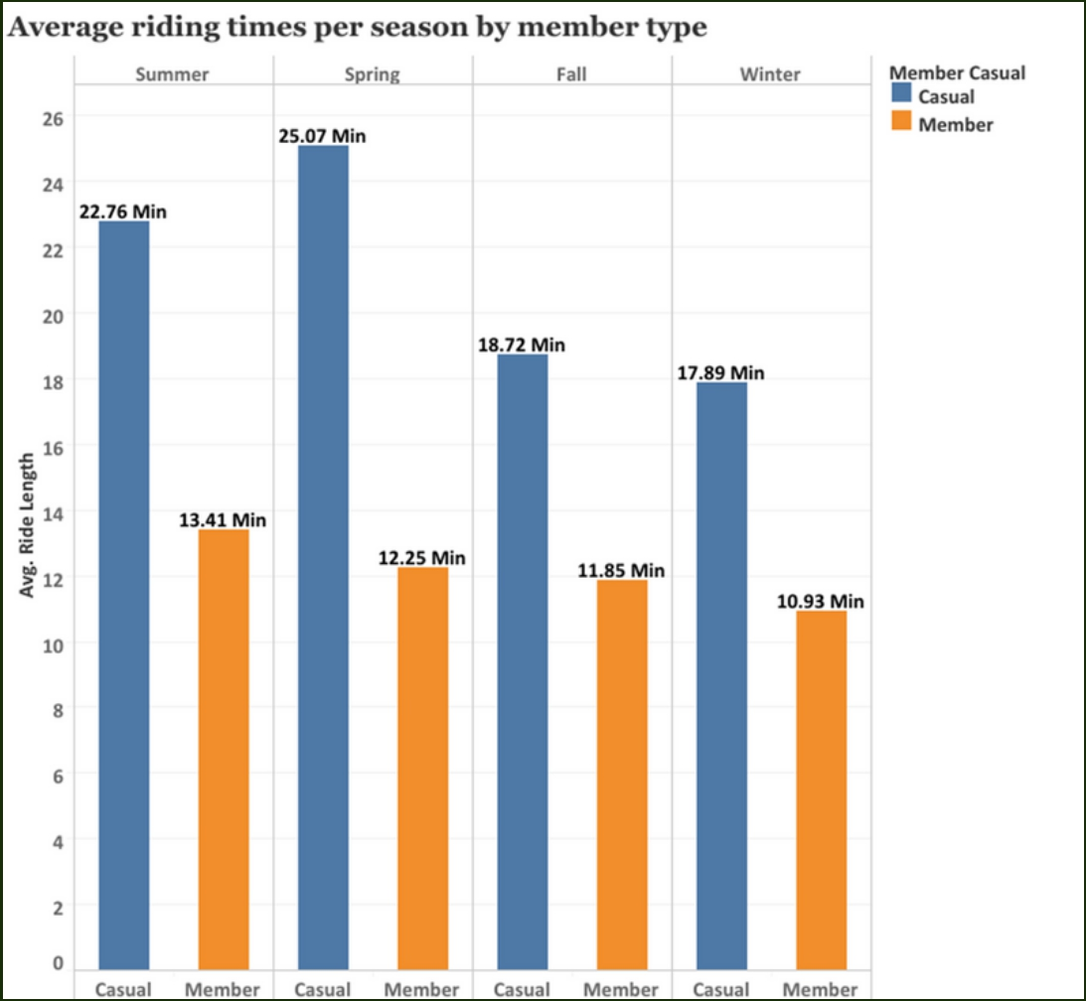
C Y C L I S T I C B I K E S H A R E
ANALYSIS SUMMARY
Average Riding Times Per Season by Member Type
Casual riders have their longest rides usually during the summer, while annual members have taken the longest rides in the spring. The shortest rides of both types of users took place in the winter season.

Slide 22
C Y C L I S T I C B I K E S H A R E
FINAL CONCLUSION AND RECOMMENDATION
My answers to the three questions that will guide the future marketing program are as follows, based on my analysis and visualizations:

Slide 23


C Y C L I S T I C B I K E S H A R E
QUESTION 1
How do annual members and casual riders use Cyclistic bikes differently?
Our annual members use the Cyclistic bike sharing service frequently and consistently in terms of total ride and ride time. It has shown that users prefer bicycles to other types of vehicles on issues such as cost, environmental pollution and traffic to use for certain jobs.
On the other hand, casual riders do not use the bike frequently and consistently. Therefore, it is understandable that they do not prefer to switch to the annual membership plan. Despite this, casual riders like to cycle inconsistently compared to annual members, with long rides on weekends that we think are for fun and relaxation.

Slide 24
C Y C L I S T I C B I K E S H A R E
QUESTION 1
How do annual members and casual riders use Cyclistic bikes differently?
Annual members are very likely to opt for the annual membership plan, as their daily and weekly routines are set. The fact that users have school, work and other activities at certain time intervals seems to push them to use a certain means of transportation in a planned way. Due to this planned use, annual membership seems quite reasonable to meet the needs of such members.
As a result, usage differences give us information about drivers' tendencies and behaviors. These differences vary according to the drivers' behaviors and perceptions of use.

Slide 25



C Y C L I S T I C B I K E S H A R E
QUESTION 2
Why would casual riders buy Cyclistic annual memberships?
The advertising and marketing strategy to get casual riders to get their annual membership plan should be around very specific issues. These issues are the cost of cycling, health, environmental health, traffic, etc. It should be noted that the benefits in these subjects are more than other tools.
In the light of the analyzes I have made; it has been observed that the reason for the annual members to use the service stems from their instincts to stick to their planned and routines in their lives. For this reason, mobile applications can be developed to encourage casual riders to move on to a planned life, and advertisements can be made for users to create routines at certain times of the day and use Cyclistic bicycles as a means of travel to these routines.

Slide 26


C Y C L I S T I C B I K E S H A R E
QUESTION 2
Why would casual riders buy Cyclistic annual memberships?
It is a known fact that time and money are very important in today's societies. For this reason, the transition to the annual plan can be encouraged by reducing the costs of the annual membership plans and by making special campaigns, sweepstakes, coupons and discounts for people who switch to the annual membership plan. Thanks to the agreements to be made with different establishments (food restaurants, cafes, book stores, entertainment centers, etc.), a system can be developed in which users can use the points they earn according to the number and frequency of driving in these establishments.

Slide 27






C Y C L I S T I C B I K E S H A R E
QUESTION 2
Why would casual riders buy Cyclistic annual memberships?
A system where driving time and number can be tracked would be very useful. Thanks to the application to be integrated into smart devices, it can be connected to other mobile applications such as Google fit and Apple Health, and the data can be created in the minds of users to create the perception that they are doing an activity to protect their health with their daily driving goals.

Slide 28







C Y C L I S T I C B I K E S H A R E
QUESTION 3
How can Cyclistic use digital media to influence casual riders to become members?
The impact of social media on marketing and campaign processes in recent times is an undeniable fact. For this reason, encouraging campaigns can be organized using social media platforms. YouTube, Facebook, Twitter, TikTok etc. With the community and activity groups to be created on social media platforms, it can be ensured that members can share in these groups. In these community and group events where existing members will register, activities such as cycling and collective trips to certain points can be organized and shared on social media accounts. Especially with the planned activities to be held on social media, effective communication can be ensured between our current users and this communication can be met on social media and attract new users to our structure.

Slide 29




C Y C L I S T I C B I K E S H A R E
QUESTION 3
How can Cyclistic use digital media to influence casual riders to become members?
Various agreements are made with the faces known to the public from social media phenomena, and the sharing of these people about the Cyclistic company in their accounts can cause a significant increase in the number of members.
Especially in media sharing tools such as YouTube and TikTok, agreements with influencers who have a channel on travel will be very effective, and the owners of these channels will use their Cyclistic bikes on their trips and make special coupons and discount draws for people watching their videos. Historical, cultural, touristic, etc. Collective trips to places can be organized through these channels and shared on social media, thus attracting the attention of more users.

Slide 30



C Y C L I S T I C B I K E S H A R E
PROJECT RESOURCES
Github.com/Cyclistic_Bike_Share_Data_Analysis
Kaggle/Cyclistic Bike-Share Capstone Project
Tableau/Cyclistic Bike-Share Capstone Project

Slide 31

THANK YOU
F A T I H I L H A N

